Slide 1
Science of Food Educator Expo
INSERT DATE/TIME/SPEAKERS

Slide 2
Agenda
INSERT AGENDA HERE

Slide 3
Overview of IFT and Feeding Tomorrow Fund

Slide 4
We are a network of 11,000 professionals dedicated to the science of food.
Our Mission: Connecting global food system communities to promote and advance the science of food and its application.
We are a community of over 2,000 undergraduate and gradate students pursing a degree in the science of food.
Our Mission: To enrich the academic experience and empower students to thrive individually and together
We are the philanthropic arm of IFT and IFTSA. Their members are our volunteers.
Our Mission: By attracting, retaining, and celebrating the most creative and innovative minds of the profession, we will ensure the world has the ability to feed a growing and diverse population.

Slide 5
A Catalyst for Positive Change

Slide 6
Sections &
Divisions
Notes:
Talk about 2-4 specific IFT programs and initiatives

Slide 7
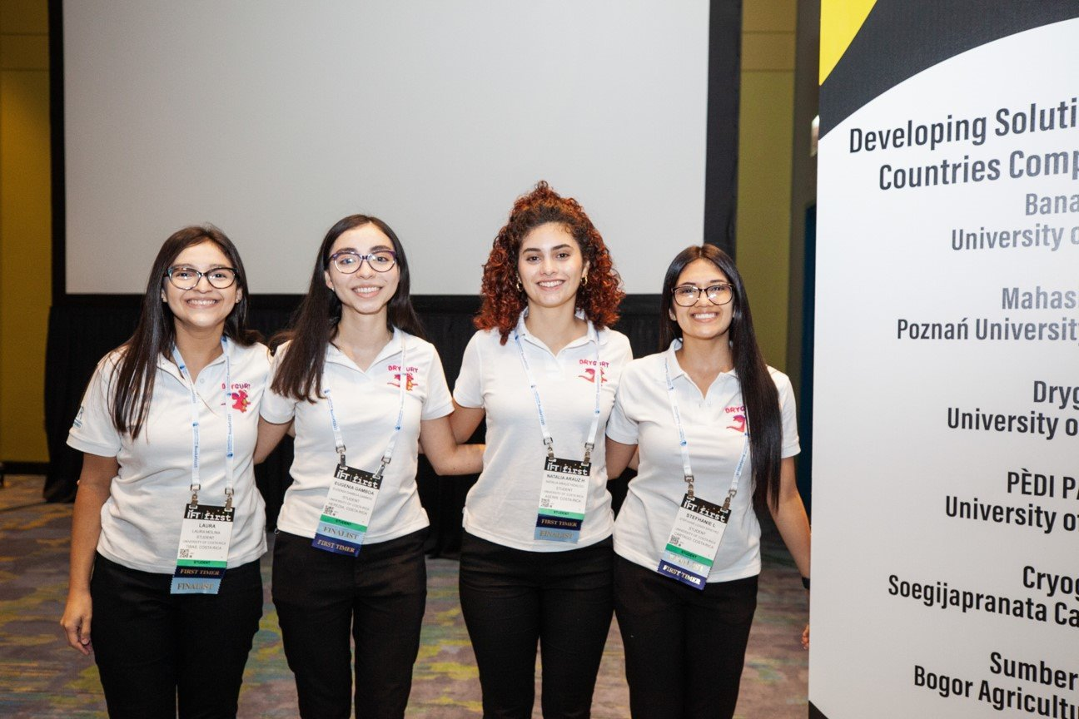
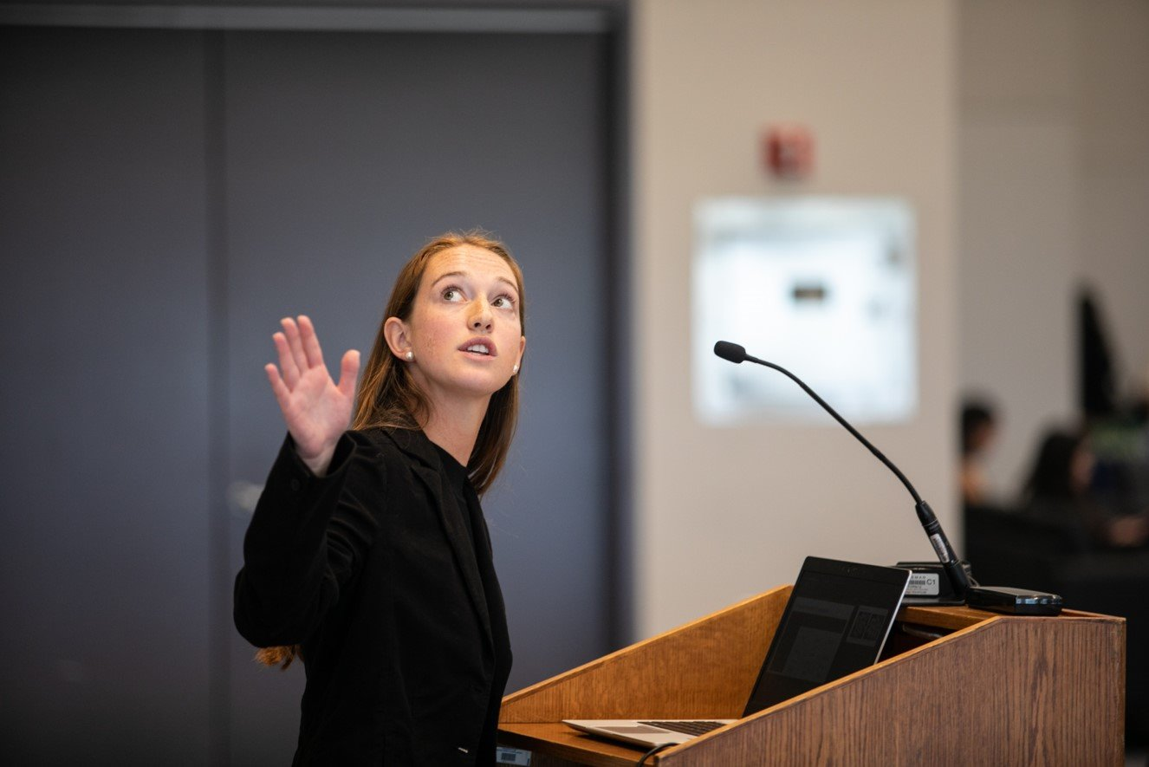
Prepare the Future & Celebrate the Community
Develop exceptional emerging professionals by providing opportunities beyond the classroom and lab
Grow student networks to facilitate meaningful connections
Advance students’ professional aptitude to enable success in their careers
Include and promote diverse perspectives and backgrounds to foster a culture of belonging
Excite members through experiences available only with the student association
Support and recognize dedicated individuals in the science of food

Slide 8
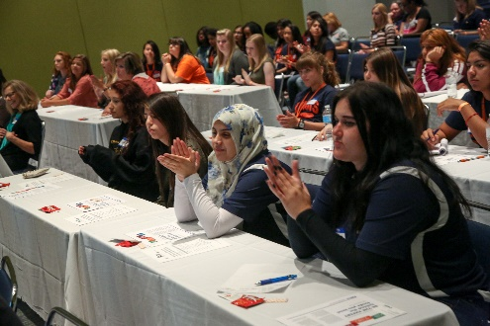
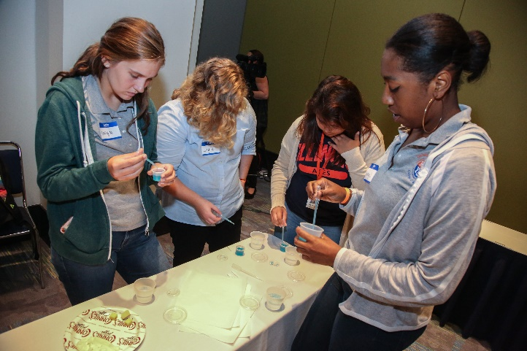
We Motivate: The world needs the next generation of creative and innovative minds engaged in the science of food to meet a critical challenge ahead of us. Yet, science of food educators report alarming declines in the number of students enrolled in food science studies.
The Feeding Tomorrow Fund is dedicated to reversing this troubling trend by inspiring the next generation to consider careers in food science—and connecting with them early.
We Support: Through the Feeding Tomorrow Fund, IFT actively addresses barriers to education in the sciences, particularly for those most impacted by food inequity. As the cost of college rises and education slips out of reach for many.
Feeding Tomorrow Fund scholarships help ensure that those passionate about careers in the science of food can still pursue their dreams. Since 1985, the Feeding Tomorrow Fund has awarded more than 2,700 scholarships, totaling over $3 million.
We Leverage: Knowledge is power. And with a global IFT community of over 60,000 strong, the foundation contributes knowledge toward food and nutrition solutions, in particular for those at the bottom of the economic pyramid.
Through a sponsorship from the Feeding Tomorrow Fund, IFTSA’s Developing Solutions for Developing Countries (DSDC) product development competition promotes the application of food science and technology and the creation of new products and processes to improve the quality of life for those in developing countries.
Through a Feeding Tomorrow Fund grant, the Nigerian Institute of Food Science and Technology (NIFST), partnered with the IFT International Division’s Food Science for Relief and Development (FSRD) project to provide food science education to 65 undergraduate and graduate students.
Programs we fund and support:
Learn About Food Science
Day in the Life of Food Scientists
June Educator Event
Pathful
Cue Career
Academic & Travel Scholarships
Feeding Tomorrow Fund Grants
Notes:
Talk about Feeding Tomorrow programs and initiatives (specifically motivate & support)

Slide 9
Representative: Why I Chose Food Science
NAME

Slide 10
Hands-On Experiments
NAME

Slide 11
Multimedia
NAME

